Slide 1

ZG6
Week 1 report
Team 2 : Fromagé Louis / Turpin Antoine / Bertucat Antoine /
Vermeulen Mathys / Fildier Romain
Notes:
6

Slide 2
Summary
Project Presentation
GANTT
Architecture diagram
Signal analyse
Graphical interface
Model

Slide 3
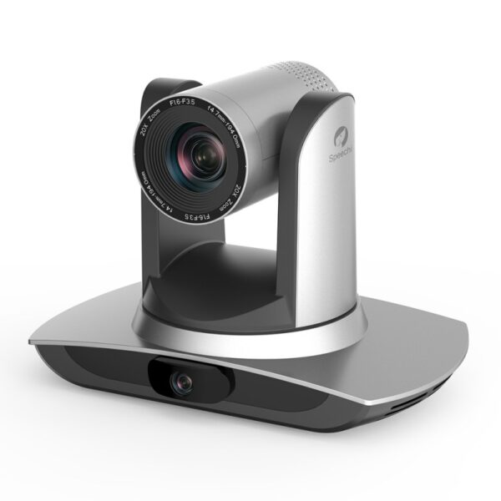
Project Presentation
vertical axis
horizontal axis

Slide 4
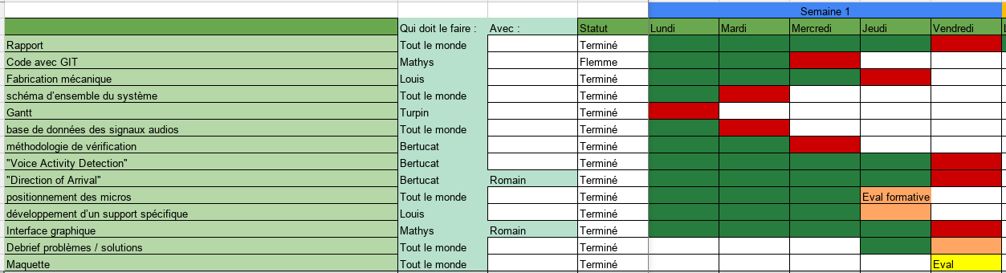
GANTT

Slide 5
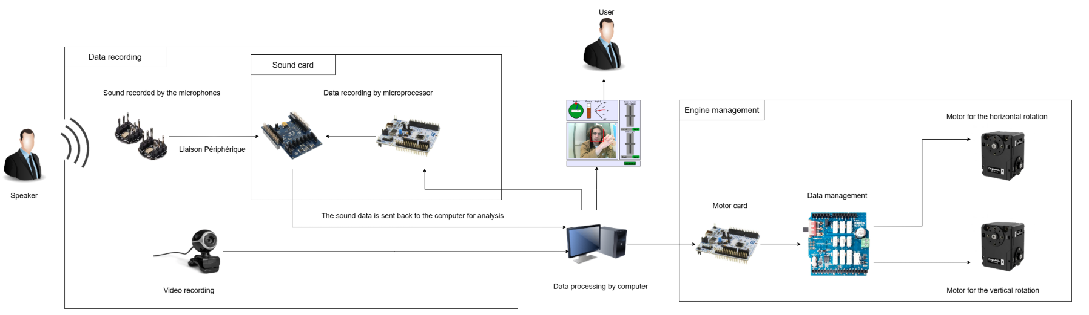
Architecture diagram
Équipe 2
<numéro>

Slide 6
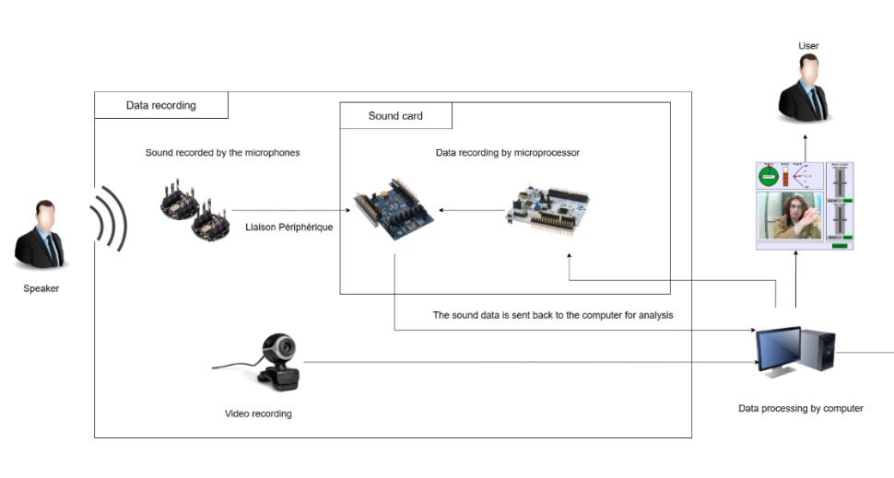
Data recording part
peripheral link
control
data
received
Frame of the camera

Slide 7
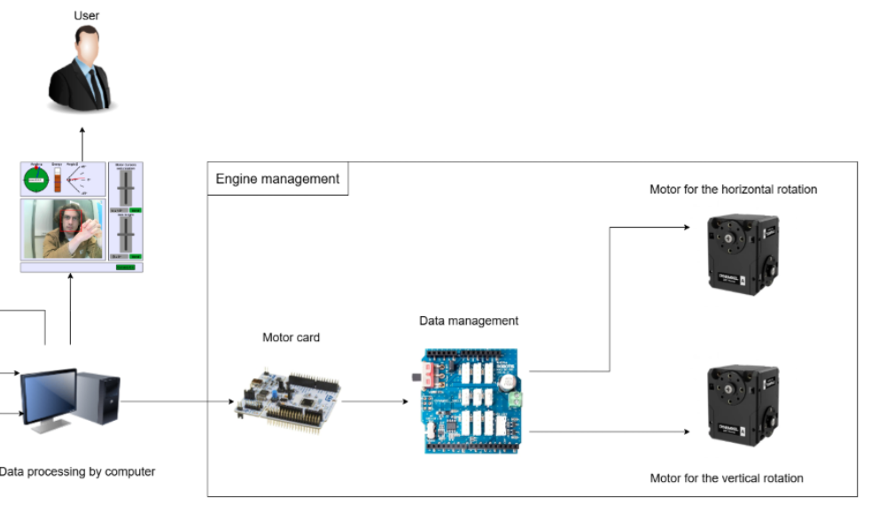
Motor control part
Horizontal and vertical angle

Slide 8
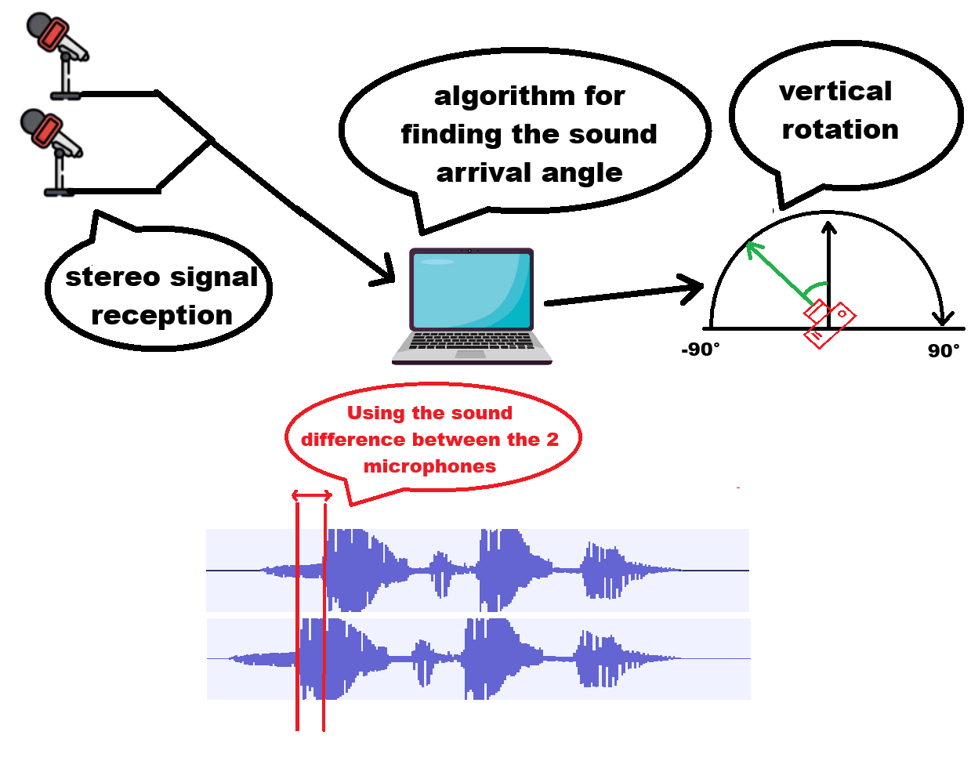
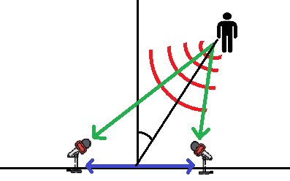
Signal analyse

Slide 9
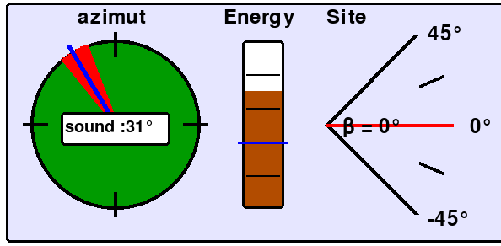
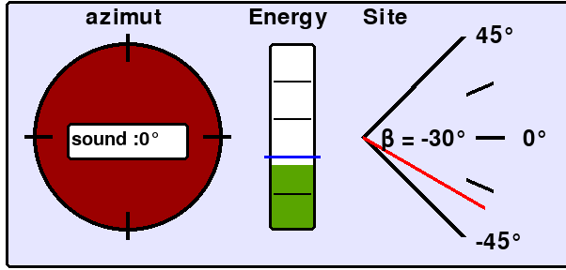
Graphical interface

Slide 10
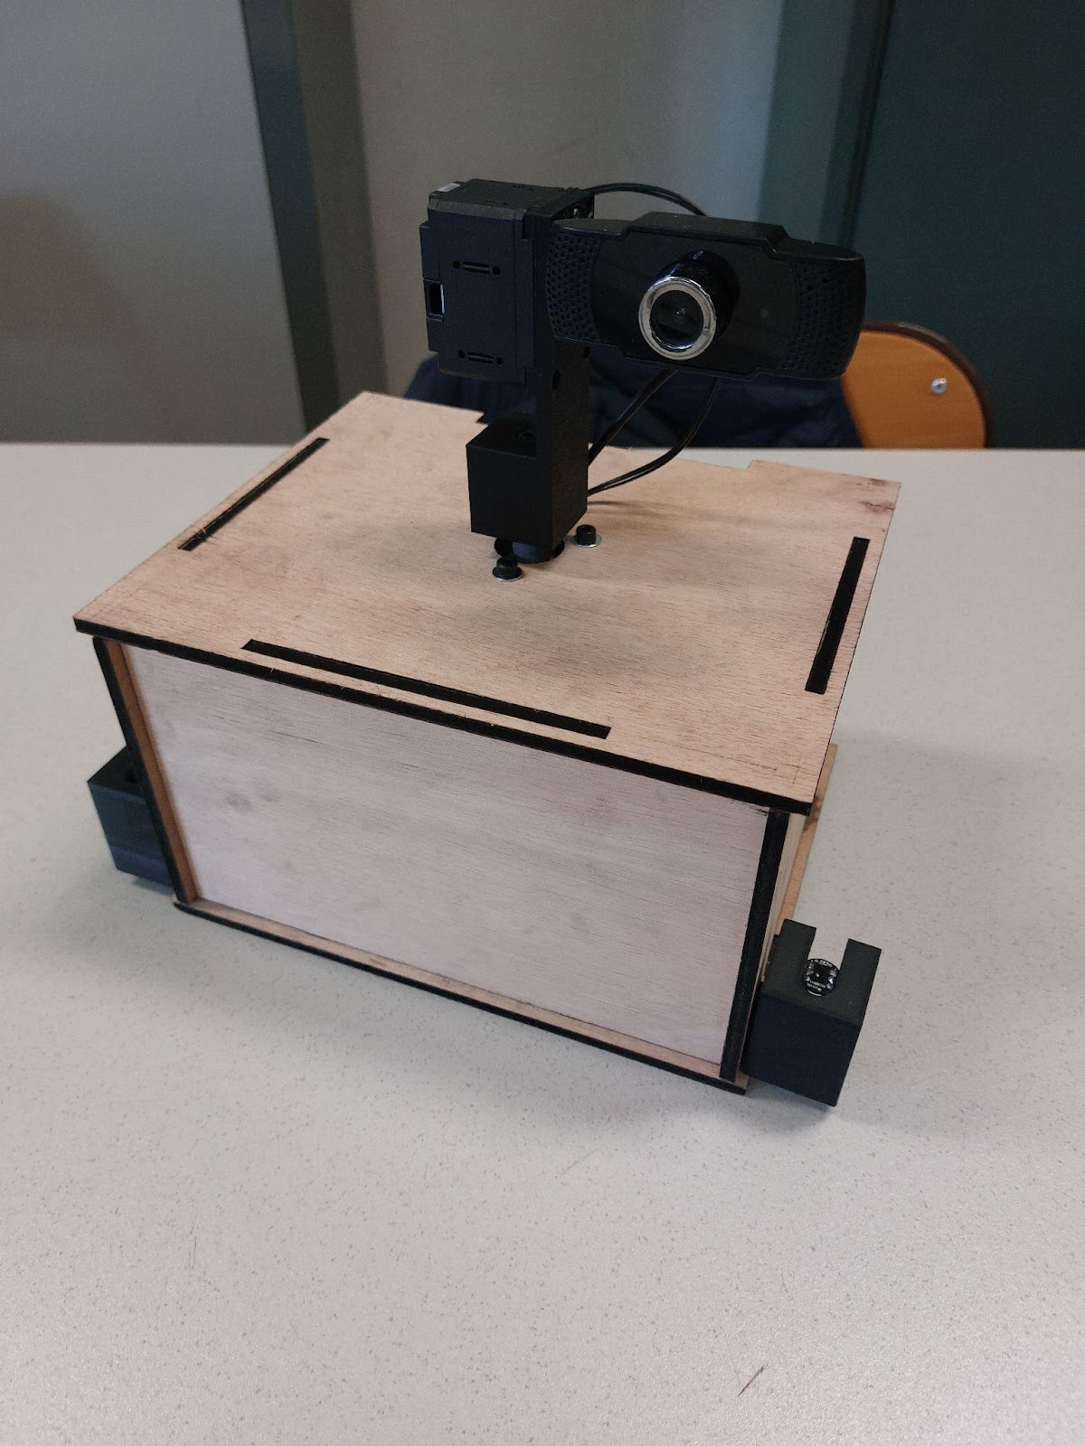
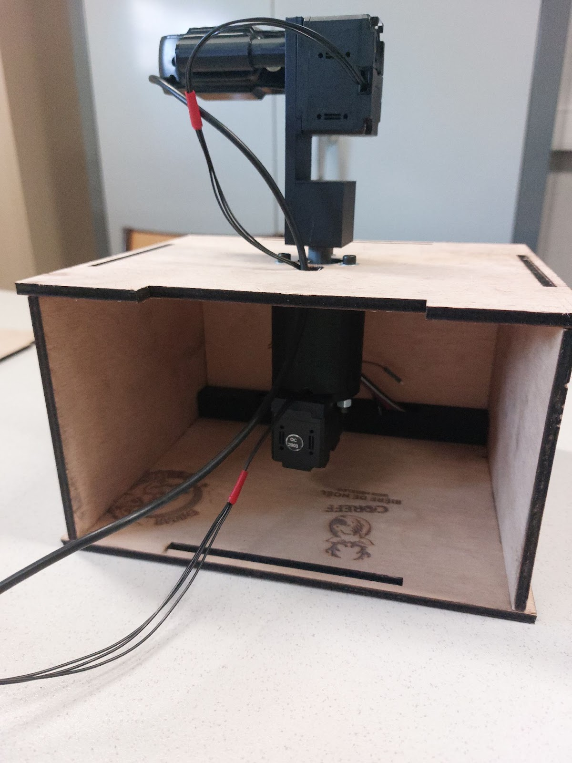
Model

Slide 11
Thank you for your attention !
6

